Slide 1

Audit Like a Pro: Securing Your NuGet Packages
Jon Douglas & Andy Zivkovic

Slide 2


Speakers
Andy Zivkovic
Senior Software Engineer
.NET Team
Jon Douglas
Principal Product Manager
.NET Team

Slide 3
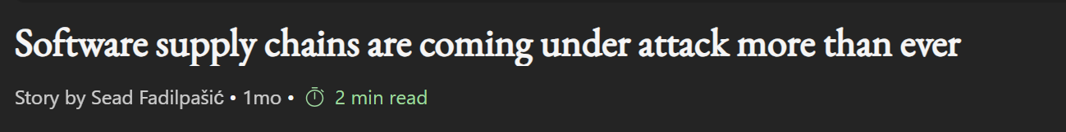
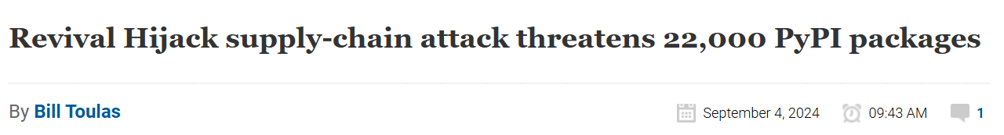
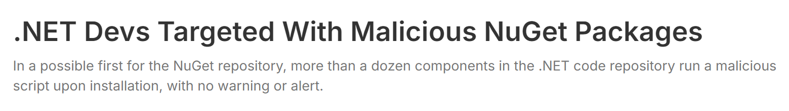

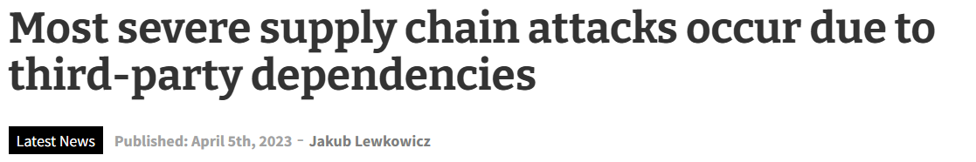
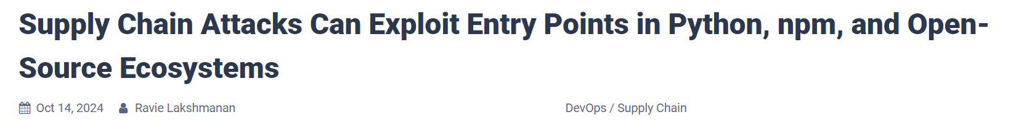


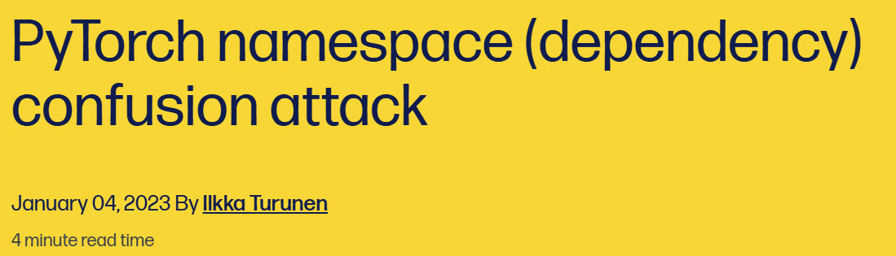
Software supply chain attacks are on the rise
Notes:
Sonatype’s 9th Annual State of the Software Supply Chain Report Reveals Ways to Improve Developer, DevSecOps Efficiency

Slide 4
Meanwhile at Contoso…

Slide 5
Feature Recap
dotnet restore: Audit improvements
Transitive dependencies: Awareness tooling
SBOM: Inclusion in dotnet SDK
dotnet nuget why: Dependency graph
Dependabot 2.0: New resolver and supports more features

Slide 6
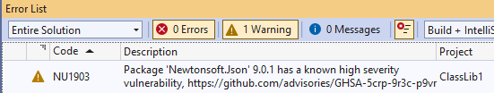
dotnet restore audit improvements
Helping you stay secure by default
The default audit now checks all dependencies, including both direct and indirect ones.
Use NuGetAuditSuppress to ignore certain warnings or advisories.
Set auditSources to use NuGet.org as your trusted source for security advice.

Slide 7
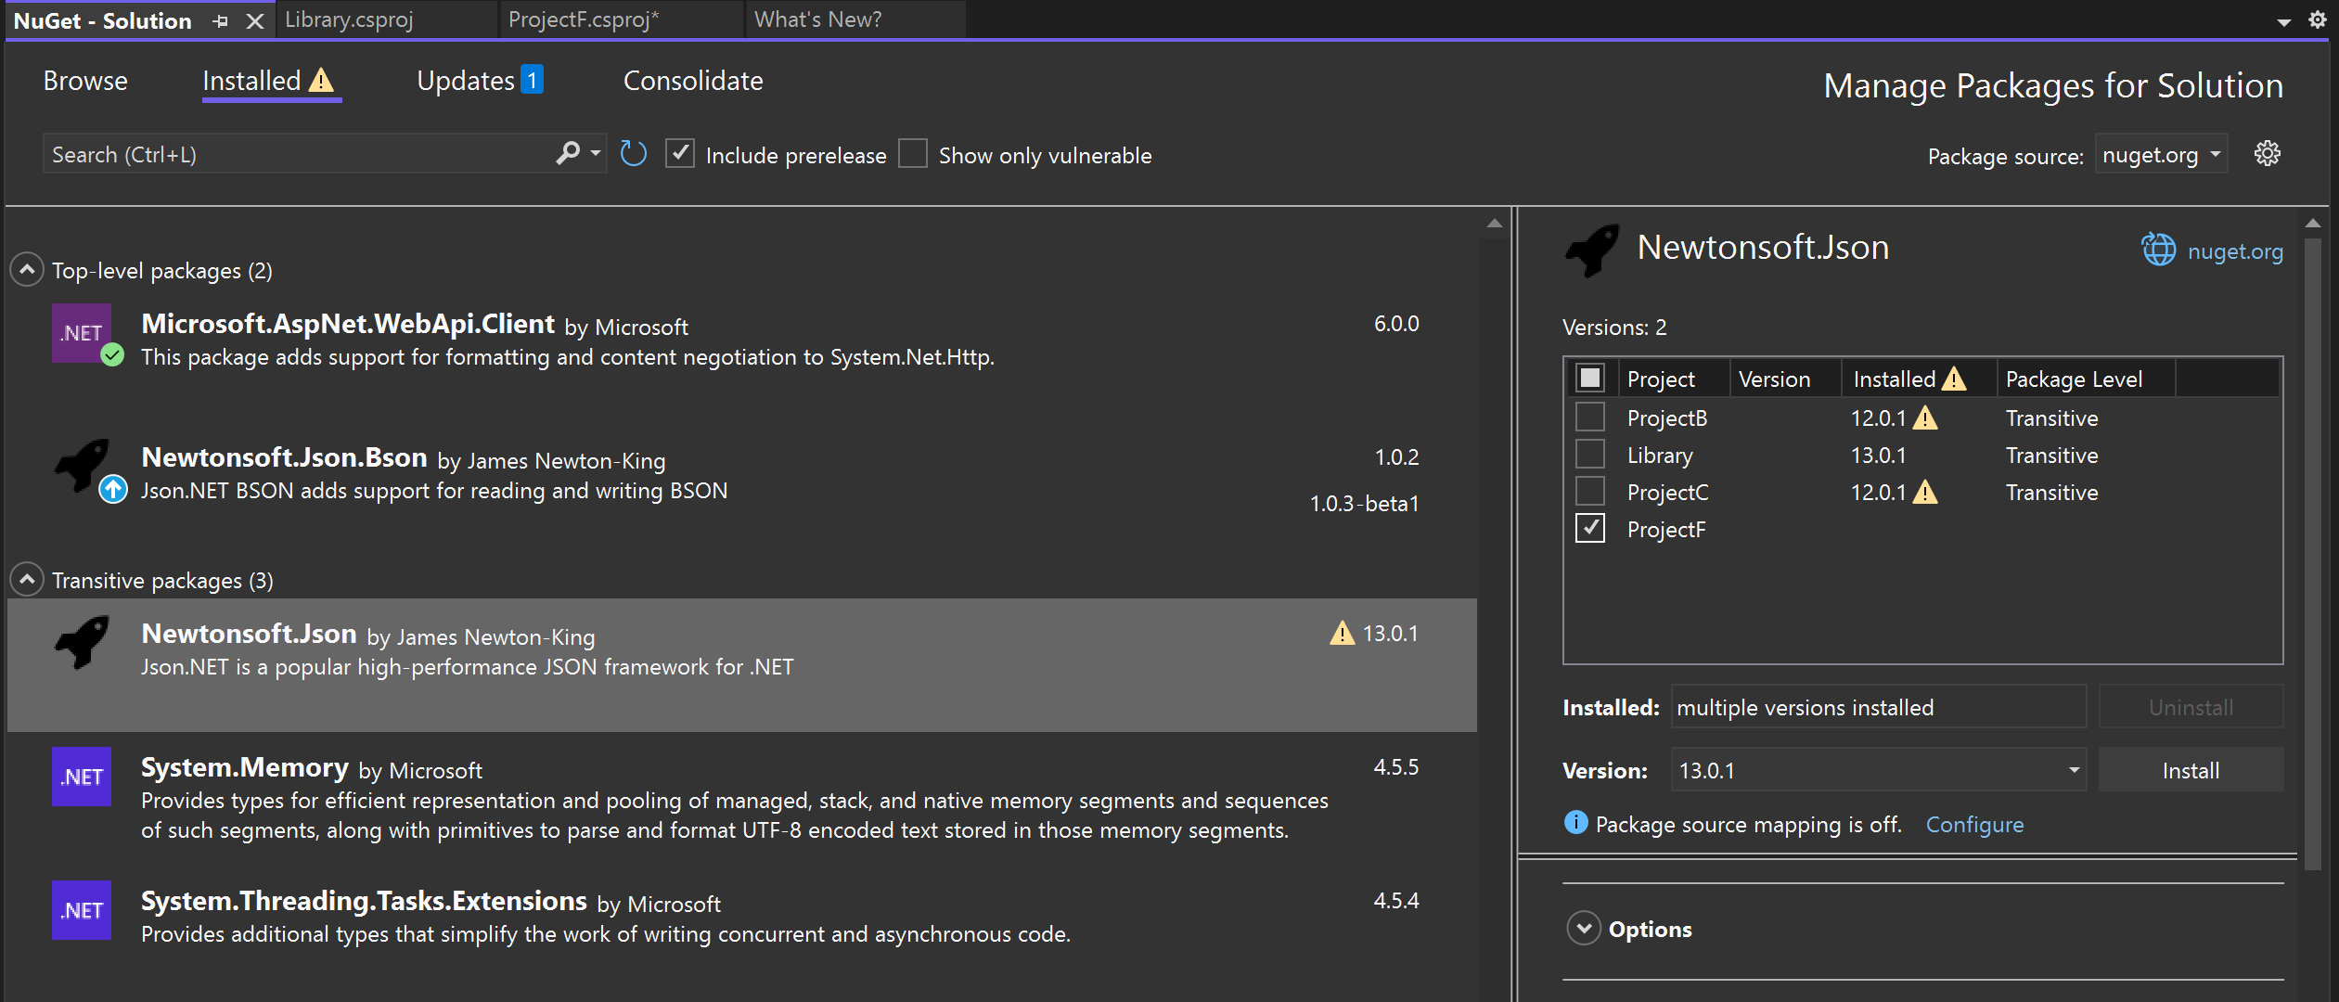
Transitive Dependencies
Know your hidden dependencies
Supported in project & solution level.
New “Transitive packages” collapsable list
Warning alerts for any known vulnerability
Know which projects are affected and which versions are vulnerable.
* Solution level experience is now in Visual Studio 17.12.

Slide 8
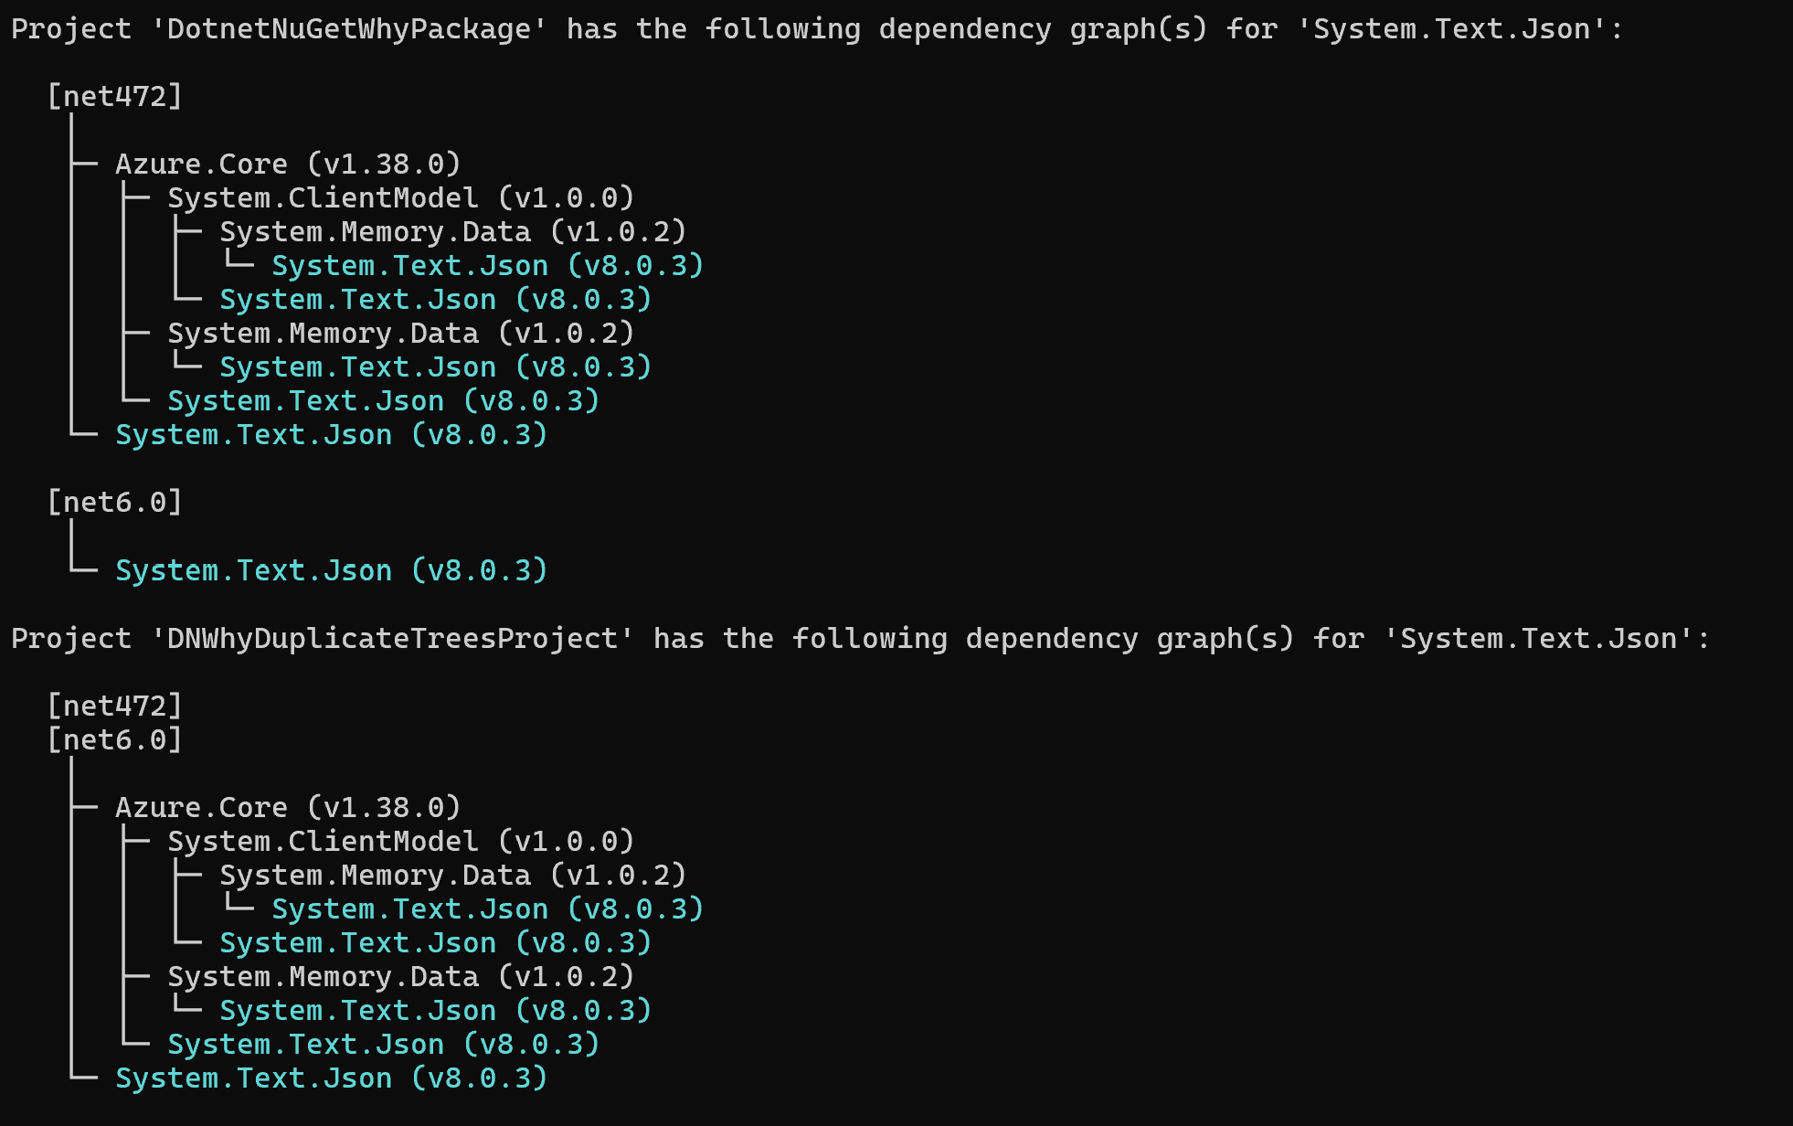
dotnet nuget why
Displays the full dependency graph for a specific package within a project or solution
Helps identify where a package is being used, including transitive dependencies
Useful for debugging dependency issues or understanding package relationships
Shows multiple target frameworks if applicable (as shown in the image)

Slide 9
Key Takeaways
Proactive auditing is essential.
Understand your dependencies.
Keep dependencies up to date.
Use tooling to make this easier.
Automate monitoring and updating dependencies.

Slide 10
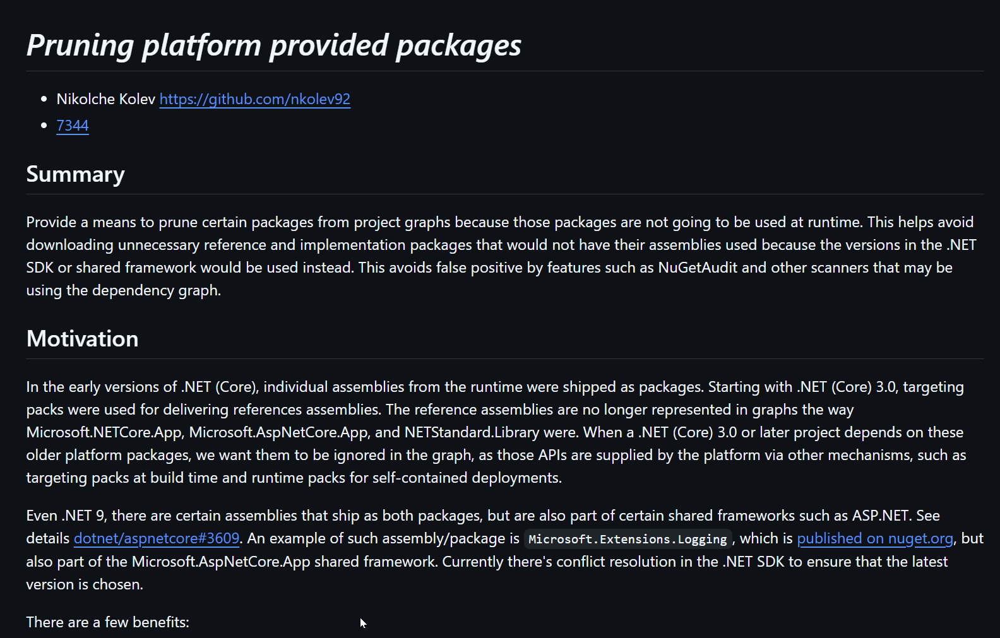
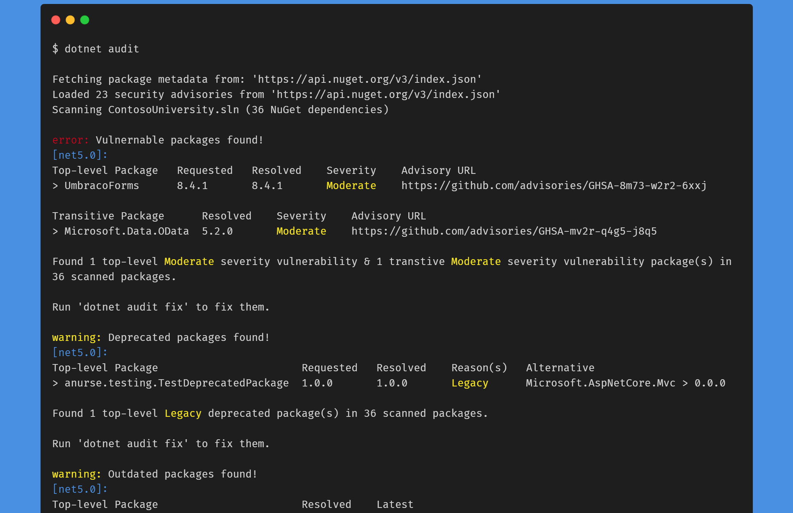
What’s Next?
Supplied by Platform / Pruning
Automatic Remediation

Slide 11
Thank you

